Slide 1


SENIOR NIGHT
Yorktown High School
Class of 2017

Slide 2
Tonight’s Agenda
Overview of things you should have completed/in progress
Early admissions options
Components of your application
Naviance/Common App
What should I be doing now?
YHS deadlines for official transcripts
& recommendations
SAT/ACT deadlines
Resources
The NVCC Pathway Program

Slide 3

Things You Should Have Already Completed or Have in Progress
Signed up/taken the SAT/ACT
Visited colleges, attended college fairs
Completed Student Brag Sheet
Completed Parent Brag Sheet
Compiled a list of colleges you’re applying to and add them to your Naviance account
Reviewed admissions requirements and deadlines for each school
Prepared personal statement/college essay

Slide 4
Components of Your Application
Who sends what? |  | How?
Student | College Application Essay(s) Resume/Activities Sheet | Online through Admissions websites, Common App, or paper
Student’s Counselor | Official Transcript Secondary School Report Counselor Recommendation Letter (if needed) | Student submits a Transcript Request Form in the Counseling Office
Teacher | Teacher Letter of Recommendation(s) Non-APS recommenders | Student submits request to teacher through Naviance Send directly to college/university
ACT/ CollegeBoard | ACT/SAT Scores | Student submits request through ACT/College Board

Slide 5
Early Admissions Options
Early Decision | Binding You can only apply to one Early Decision school Admission is granted usually by December 1st
Early Action | Non-binding You can apply to multiple schools Admission is granted usually before winter break Students usually have until May 1st to commit to a school
Rolling Admissions | You can apply whenever you want Admission is granted on a first-come, first-serve basis so you can apply early for an early notification
Note: Regardless of admissions option, students should pay close attention to deadlines for scholarship consideration (merit and need based)!

Slide 6

Naviance
Naviance is the “portal” counselors and teachers use to submit supporting documents for students.
It allows students/counselors the ability to track those submissions.
It can be accessed through the YHS website under the Parent or Student tab (Naviance for Families)

Slide 7

What Should I Be Doing Now?
Create a Common App Account
Sign the Common App FERPA Release Authorization
Match Common App with your Naviance Account
Finalize “Colleges I’m Applying To” list
Request teacher recommendation(s)
Submit Transcript Request Form to Counseling Office

Slide 8
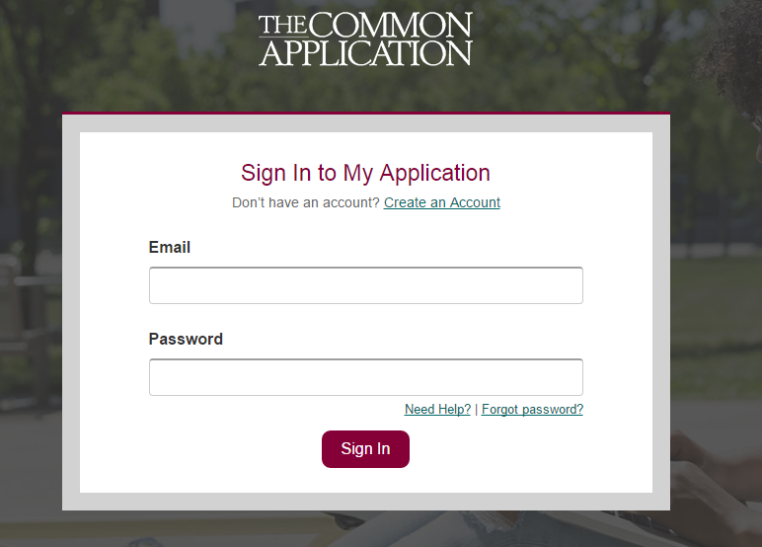
Step 1: Create a Common App Account
(Even if you don’t plan to apply to any Common App schools)
www.commonapp.org
Step 2: Sign the Common App FERPA Release Authorization
(Go to the Common App tab and fill out the Education portion to add YHS)

Slide 9
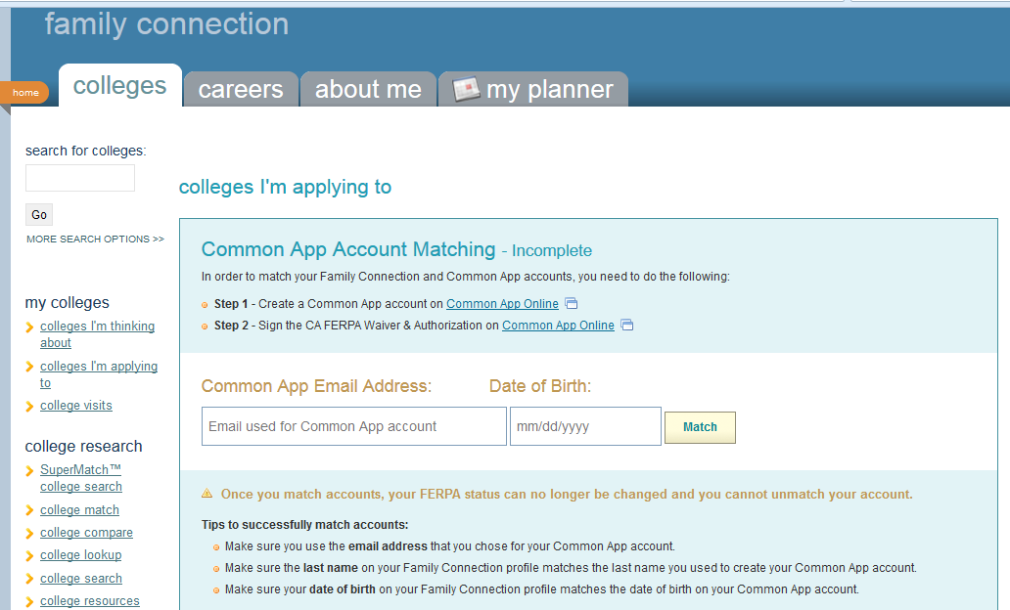
Step 3: Match Common App with Your Naviance Account

Slide 10
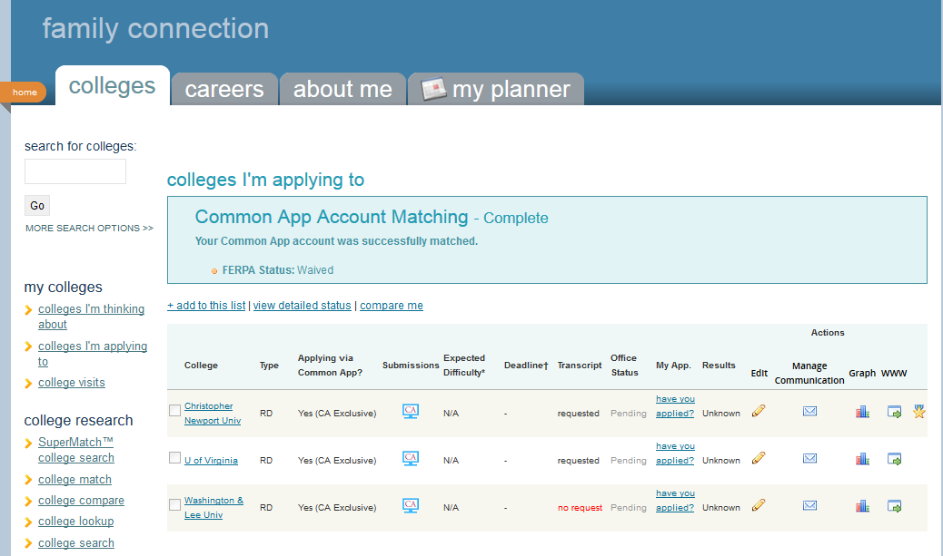
Step 4: Finalize “Colleges I’m Applying to List”

Slide 11
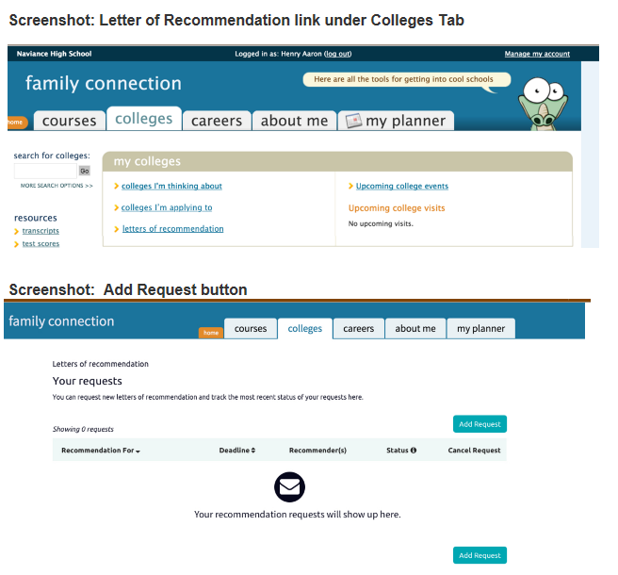
Step 5: Request Teacher Recommendations

Slide 12
Step 5: Request Teacher Recommendation(s)

Slide 13
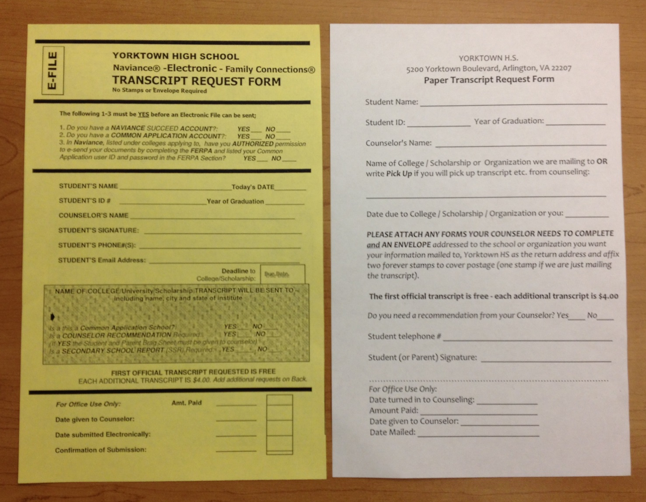
Step 6: Submit Transcript Request Form to Counseling Office
Electronic Request Paper Request
You can find these forms in the Counseling Office
or
Print them directly from the Yorktown Counseling page (under “Forms”)

Slide 14
Step 6: Submit Transcript Request Form to Counseling Office
The first official transcript is FREE- each additional is $4.00
For paper requests:
Attach any forms your counselor may need to fill out
Attach an addressed envelope to the school or organization you want information mailed to
List Yorktown High School as the return address
Attach 2 stamps to cover postage (1 if we’re just mailing a transcript)
Yorktown High School
5200 Yorktown Blvd.
Arlington, VA 22207
JMU Office of Admissions
Sonner Hall- MSC 0101
481 Bluestone Dr.
Harrisonburg, Virginia 22807

Slide 15
YHS Deadlines for
Official Transcripts & Recommendations
College Due Date | Yorktown Deadline
October 15 November 1 November 15 December 1 December 15 January 1 January 15 February 1 February 15 March 1 | September 23 October 3 October 14 November 4 November 18 December 2 December 14 January 9 January 25 February 8

Slide 16


SAT/ACT Deadlines
SAT
Deadline to Register | Test Date
October 7 November 3 December 21 | November 5 December 3 January 21
ACT
Deadline to Register | Test Date
September 16 (late – 9/30) November 4 | October 22 December 10

Slide 17

Resources
College & Career Office- Rm 107
Meet with College Admissions Representatives
Meet with Ms. McCord- College & Career Coordinator
Minority Achievement Office – Rm 223
For scholarship help
If you are not a US citizen or permanent resident see
Ms. Benites
Scholarship Resources
“Scholarship List” under the COLLEGES tab
Scholarship Bulletin sent through Naviance e-mail
Fastweb.com
Meet with Ms. McCord- College & Career Coordinator
SAT/ACT Test Resources
Naviance Test Prep

Slide 18

Resources
APS College Night 2016
Tuesday, October 18, 2016
Washington-Lee High School
1301 N. Stafford Street
6 – 8 pm
Speak with representatives from over 150 colleges,
universities, trade schools, and careers!
Panel discussion from 6 – 7pm on the
College Admissions Process
Go to www.gotocollegefairs.com to preregister!

Slide 19

Upcoming Library Resources
Scholarship Searching
Monday, October 17, 2016
Time: 7:30 p.m. - 8:45pm
Auditorium, Central Library
For more information, please contact the College & Career Librarian at 703-228-5988
College Search
Monday, October 3, 2016
7:30 p.m.- 8:30 p.m.
Auditorium, Central Library
Getting into College: Understanding the SAT/ACT and College Admissions Process
Tuesday, October 11, 2016
7:00 p.m. - 8:45 p.m.
Large Meeting Room at Westover Branch Library

Slide 20

The NVCC Pathway Program
What is it?
A two-year college-access and guaranteed admissions program at NOVA
It provides students transition support from high school, while you’re a student at NOVA, and as you transfer to a four year school
Open to all seniors
There is no minimum GPA, but “strong consideration” given to:
Barriers to college access | Recent grades
Attendance | Future goals
Even if you are considering NOVA as an option,
you should still apply!
****Applications are due to counseling office first week of November****

Slide 21
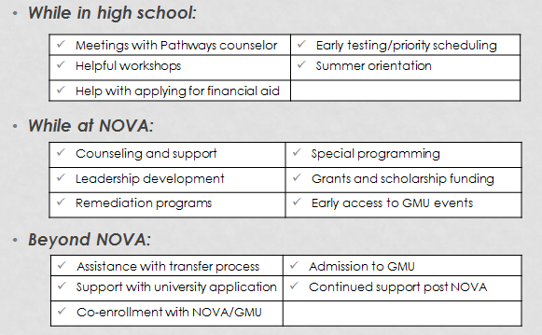
The NVCC Pathway Program
A great way to get into your dream school!

Slide 22
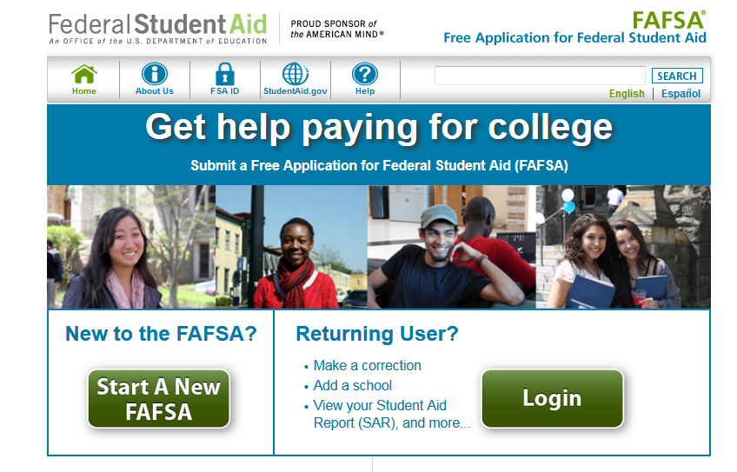
Financial Aid – FAFSA
Opens October 1, ,2016
https://fafsa.ed.gov/

Slide 23
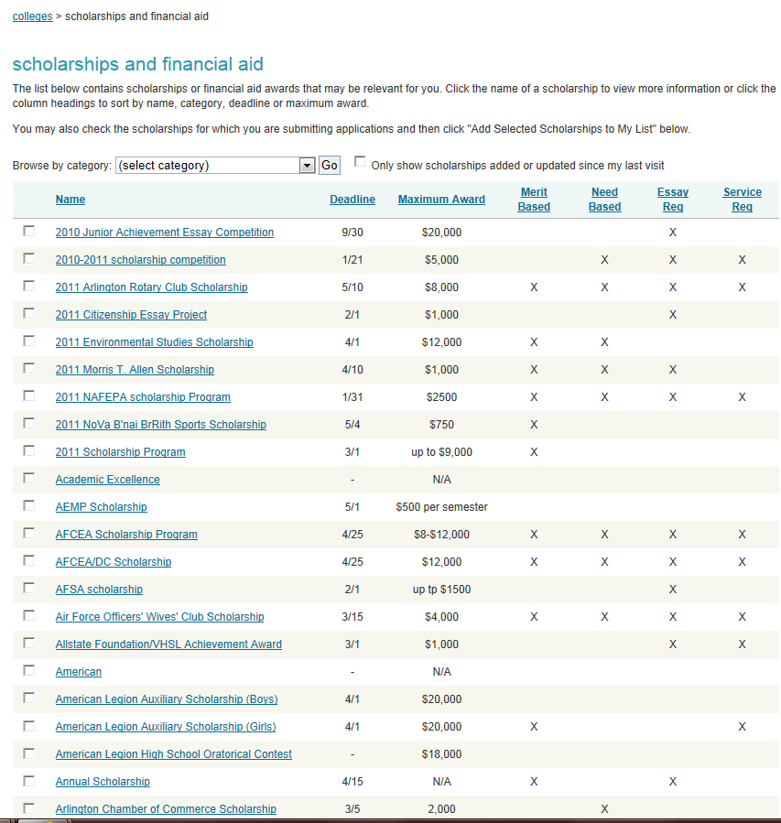
Financial Aid - Scholarships

Slide 24
Frequently Asked Questions
Does Yorktown High School rank students?
When do Senior Year grades get sent to colleges?
How long does it take for the transcript to be sent?
What is our GPA scale? It is unweighted or weighted?
When should we submit the transcript request form?
The college says they are missing something! What should I do?

Slide 25
Any Questions?
Mr. MD Calabro – Counselor
md.calabro@apsva.us
Ms. Fatima Pineda - Counselor
fatima.pineda@apsva.us
Mr. Jeff Stahl - Counselor
jeffrey.stahl@apsva.us
Ms. Yuchen Zhang - Counselor
yuchen.zhang@apsva.us
Ms. McCord- College & Career Coordinator
martie.mccord@apsva.us
Ms. Collette Julian- NVCC Pathways Counselor
cjulian@nvcc.edu

